Slide 1

Marist Syllabus Evaluator
A Software Application
Developers: Chris Crawley, Emily Doran, Tommy Burda
IT Professional/Designer: Brendan Bartow
Project Manager: Abel Simon
"It's pretty good!" - Professor Glomski

Slide 2

About: Why Is The System Useful?
A One Stop Syllabus Suite
Create or validate syllabi through our system
Automation
Eases the job of the Marist Curriculum Committee's members
High Functionality
A flexible system with additional complimentary features for faculty to enjoy
2

Slide 3
Core Functionality
Secure login system
Accept common filetypes
Syllabi scoring system
Sentiment analysis
Viewable sample syllabi
Admin accounts
Syllabi creation
Syllabi Storage

Slide 4
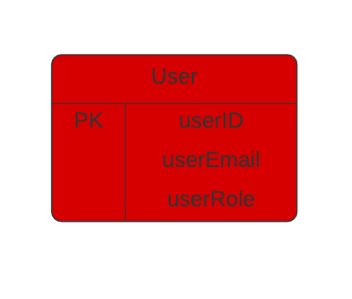
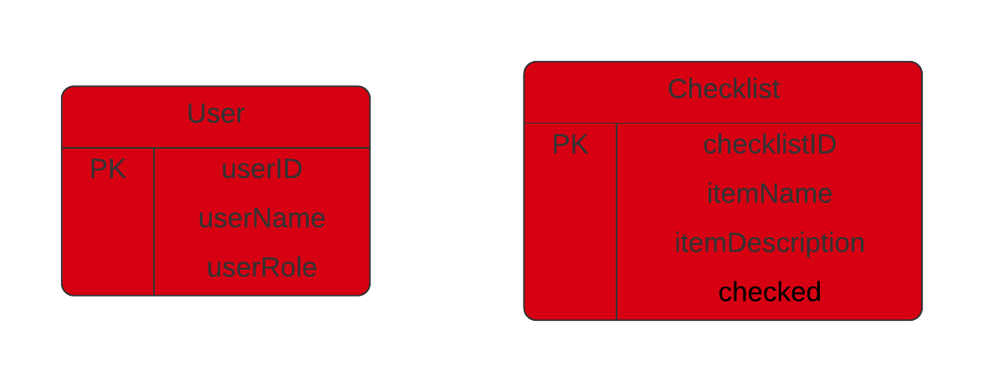
Entity Relationship Diagram
Database is hosted as DB2 on Cloud
Checklist entity used to determine items they're graded by, modifiable by admins
User role retrieved from database to determine access level (admin / user)
4

Slide 5
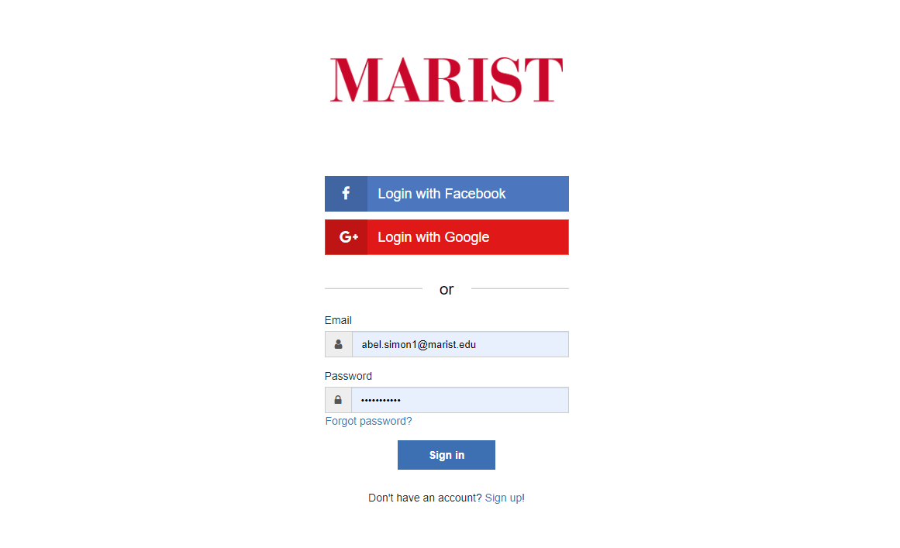
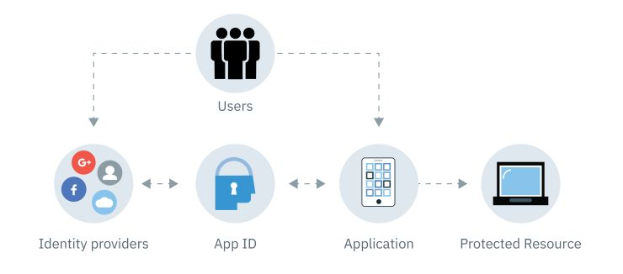
Login & Security
IBM App ID Service for Authentication
Node.js integration using Passport
Sign up to create an account in the Cloud Directory, or login with a pre-existing Google/Facebook account
User email and role are stored in database

Slide 6
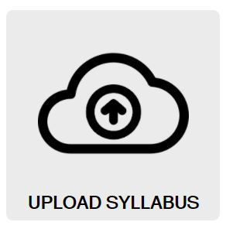
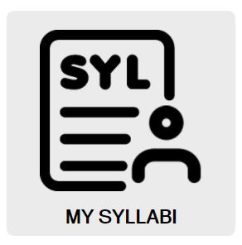
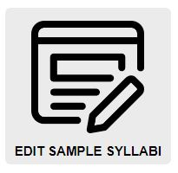
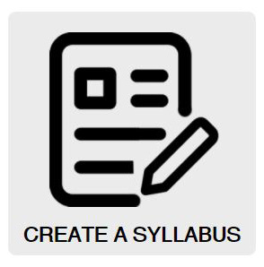
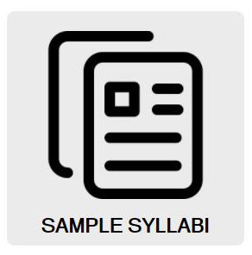
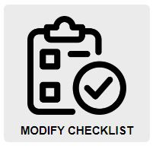
Feature Overview
Admin Features

Slide 7
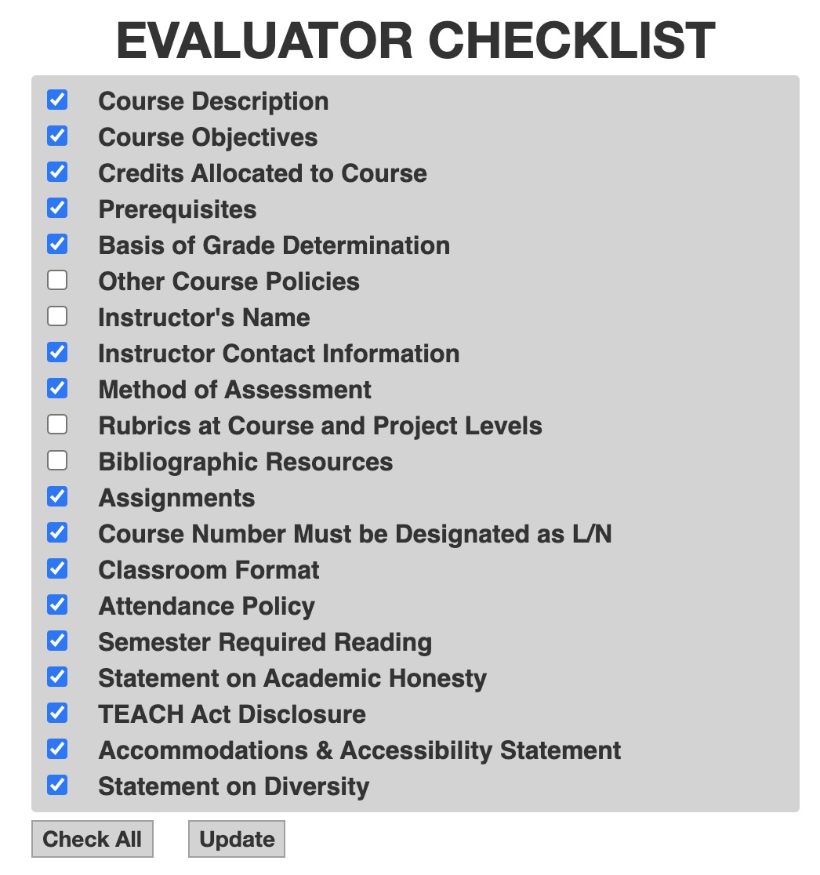
Checklist Modification
Admins determine the grading checklist
Choose the items that the analysis will check for and score during
syllabus evaluation​
Normal users cannot access this checklist​
Affects grading

Slide 8

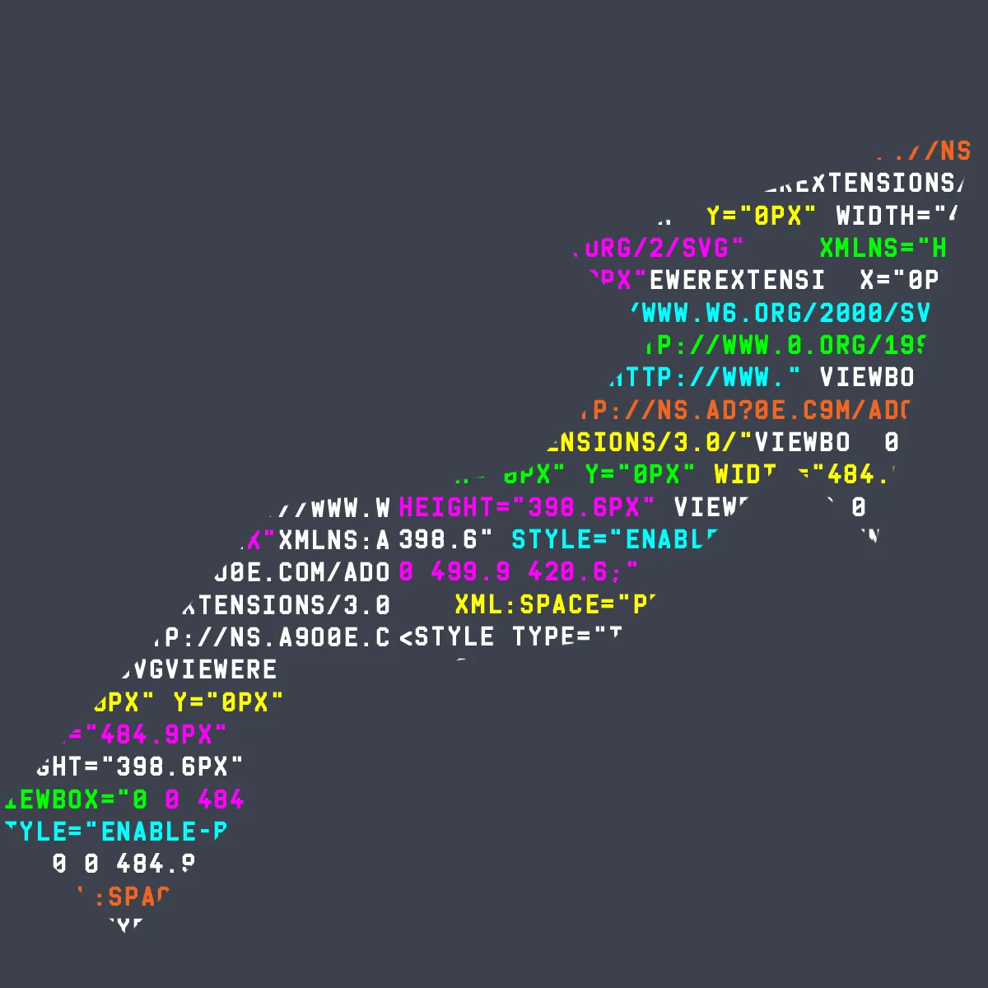
Syllabus Evaluation
Keyword Analysis: Python On Backend
1. Requirements listed as keys in the dictionary, leading to an array of RegEx expressions
2. Uploaded Syllabus converted to .txt file
3. Program loops though every line, checking for matches
4. Grade determined by # of missing requirements
(A – F)
Level 1: Basic keywords
Only a basic keyword search was needed for some items
Teachers all use different wording for different requirements so many keywords are needed for each item...
Ex: Academic Honesty Searches: "academic honesty" , "cheating" , "plagiarism"

Slide 9
Level 2: Regex Searches
Some items could not be handled by keywords. For these we had to find creative ways to search for them through regex commands
Level 3: Special Cases
Other items had no universal regex searches that could be hard coded into the system. This necessitated new code to add specialized searches after initially reading the syllabus
Ex: Course Code Search... ​
​
"[0-9]{3}( |_)*(N|L|n|l)( |_)*[0-9]{3}"​
Ex: Instructor's Name​
​
Looked for "@marist.edu" then parsed for prof name in e-mail and added that expression to the array for instructor's name
Any 3 digits
_ or space
_ or space
Any 3 digits
N or L
475_N_113

Slide 10
Sentiment Analysis
👦
Using the natural node package, we utilize the Sentiment Analysis function to get a read on the Sentiment
Simple algorithm that assigns polarity to words.
Returns positive/negative sentiment as numerical value
Value is normalized to fit on a 0-100 scale, 0 being the lowest, 100 being highest
😋
😒
😉 ​

Slide 11
On upload, you can view misspelled words in the 3rd drop down box.
Uses the spellchecker-js node package in order to check for misspelled words.
The spellchecker function then compares the syllabi against two dictionaries to see if any of the words are misspelled.
Spellcheck

Slide 12

User Saved Syllabi
The system also includes a page where all users can view and edit their previously submitted syllabi
Users can also download their syllabi from this page
Each user has a dedicated 'bucket' in the Cloud Object Store for simple retrieval of their stored syllabi

Slide 13
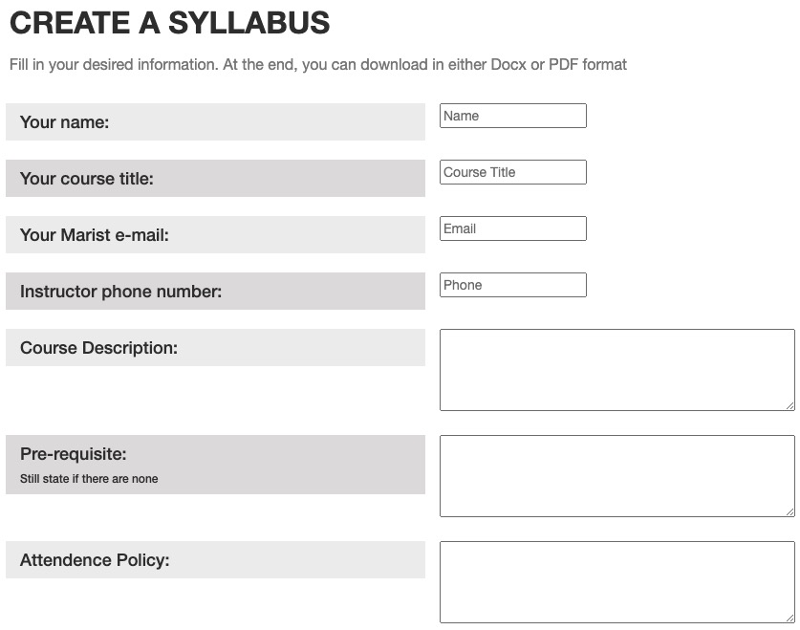
Create Syllabus From Template
Users have the ability to create their syllabus on the syllabus evaluator website
We provide a template with all the required items given their own text boxes
Once the template is filled out the users can choose to download their syllabus as a PDF or editable docx
The template is made entirely on the client side using the JSpdf and the DOCXjs libraries
Several styling options available (font, logo style)
...
Download as pdf, doc,
Select font and header image

Slide 14
Sample Syllabi Page
Users can view a selection of sample syllabi
Samples have been run through system and scored grades of B or higher
Syllabi can be downloaded or viewed in browser depending on file type
Majority of requirements are fulfilled in these syllabi

Slide 15

Sample Syllabi Modification
Admins can modify selection of sample syllabi viewable to users
Samples are stored in Cloud Object Store bucket
Accepts .doc, .docx, .pdf, .pages file types

Slide 16


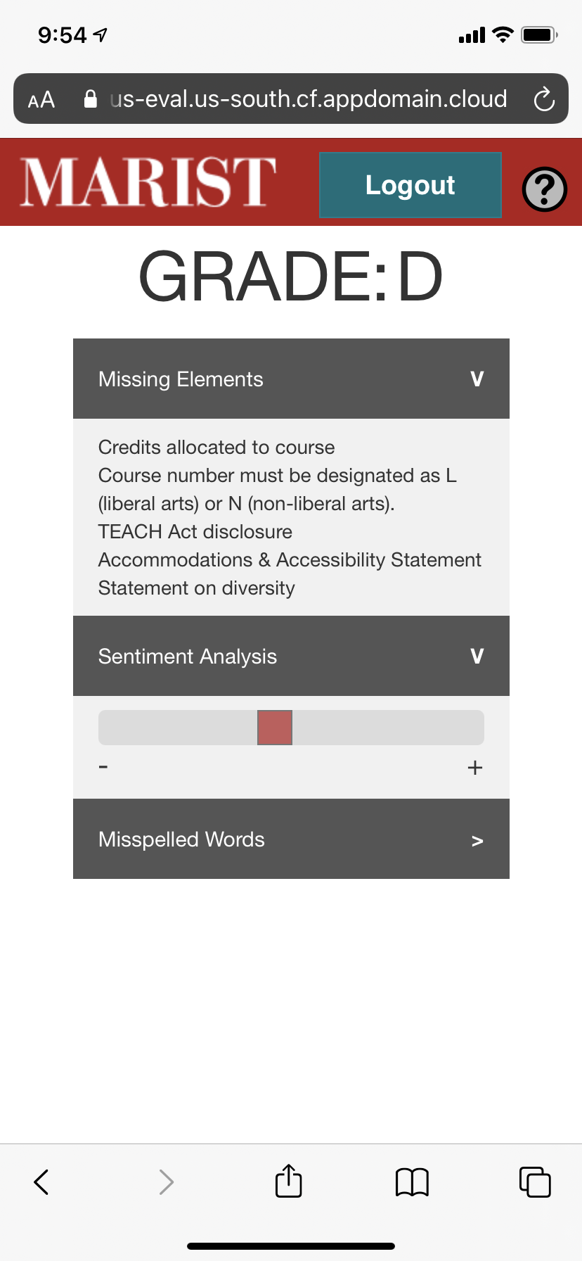

Additional Features
Hosted as IBM Cloud Foundry Application
Instructions for Easy Docker Installation ​
Smartphone Functionality
Help Page with instructions for system usage

Slide 17
Demo: Cloud Site
https://syllabus-eval.us-south.cf.appdomain.cloud/

Slide 18
Thank You
Questions?

